Slide 1
RENTAL PROPERTY PRICE PREDICTION

Slide 2
Problem Statement:
In the real estate industry, determining the appropriate rental price for a property is crucial for property owners, tenants, and property management companies. Accurate rent predictions can help landlords set competitive prices, tenants make informed rental decisions, and property management companies optimize their portfolio management.
The goal of this project is to develop a data-driven model that predicts the rental price of residential properties based on relevant features. By analyzing historical rental data and property attributes, the model aims to provide accurate and reliable rent predictions.

Slide 3
Tools Used:
Python
Numpy
Pandas
PostgreSQL
Streamlit
Scikit-learn
Plotly
Matplotlib
Seaborn

Slide 4
Exploratory Data Analysis (EDA) Insights

Slide 5
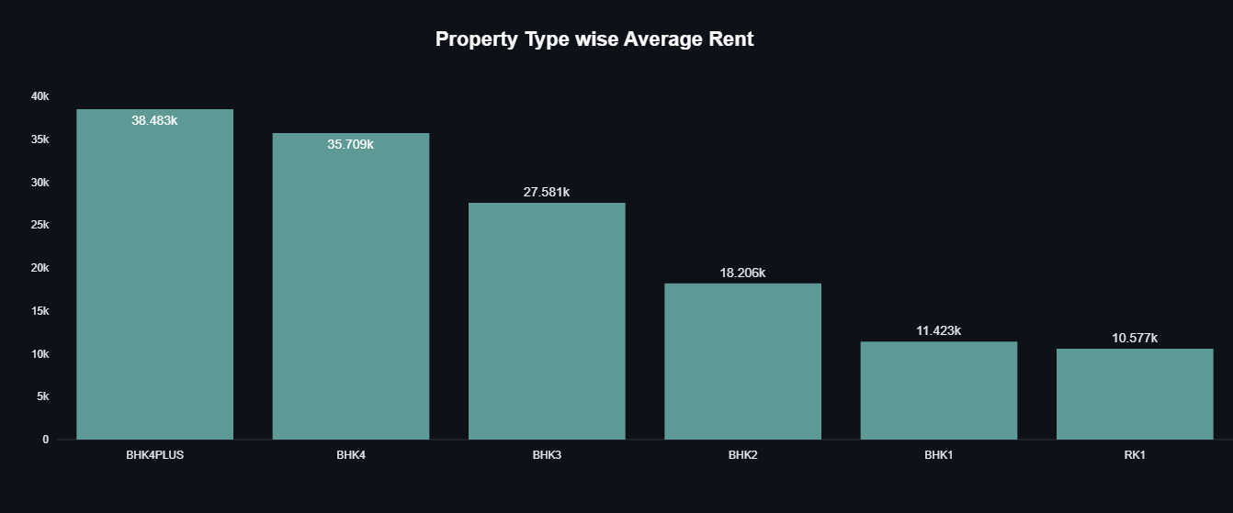

Slide 6
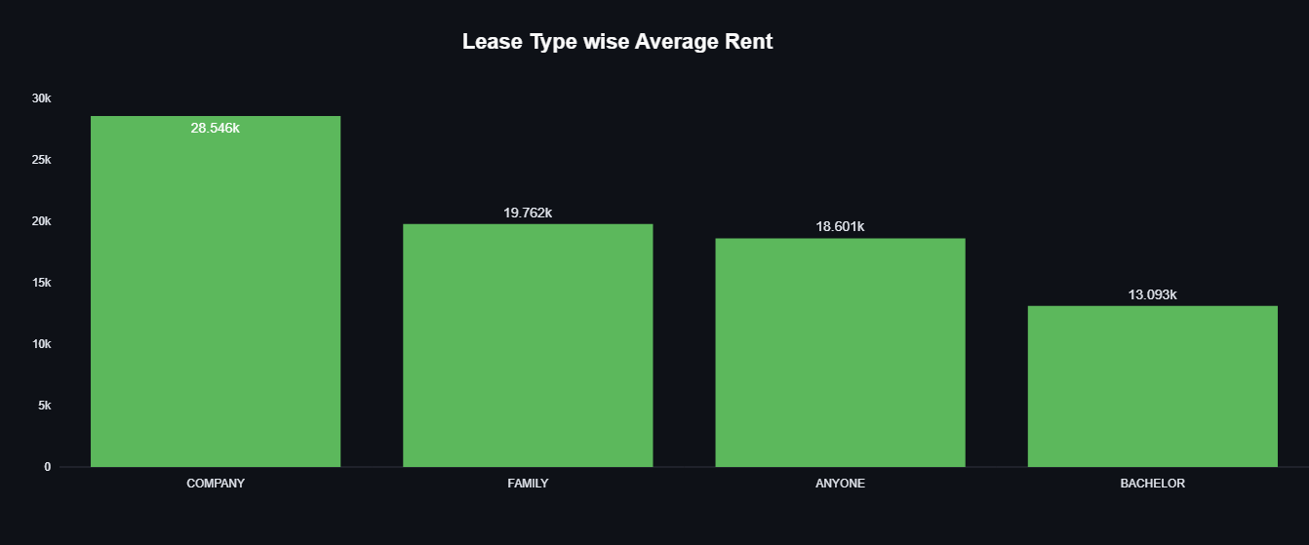

Slide 7
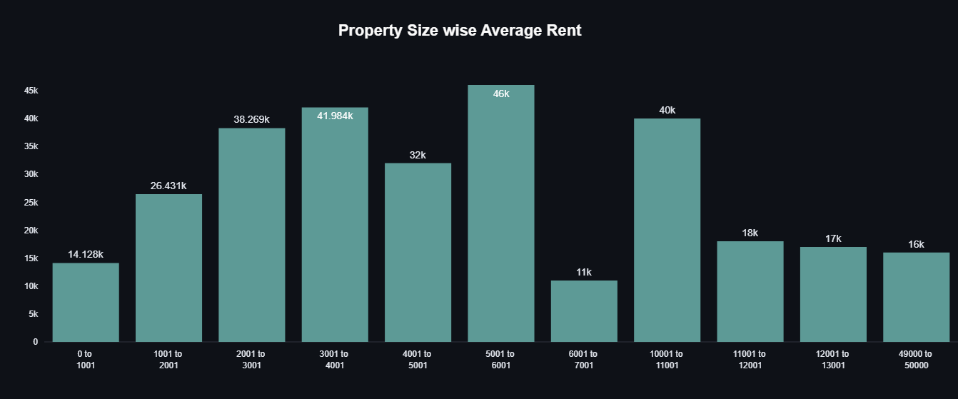

Slide 8
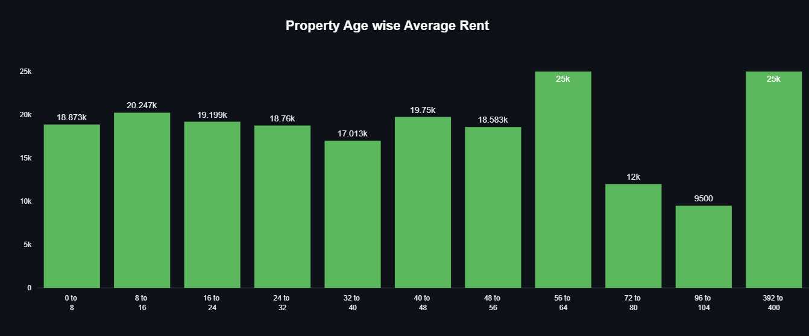

Slide 9
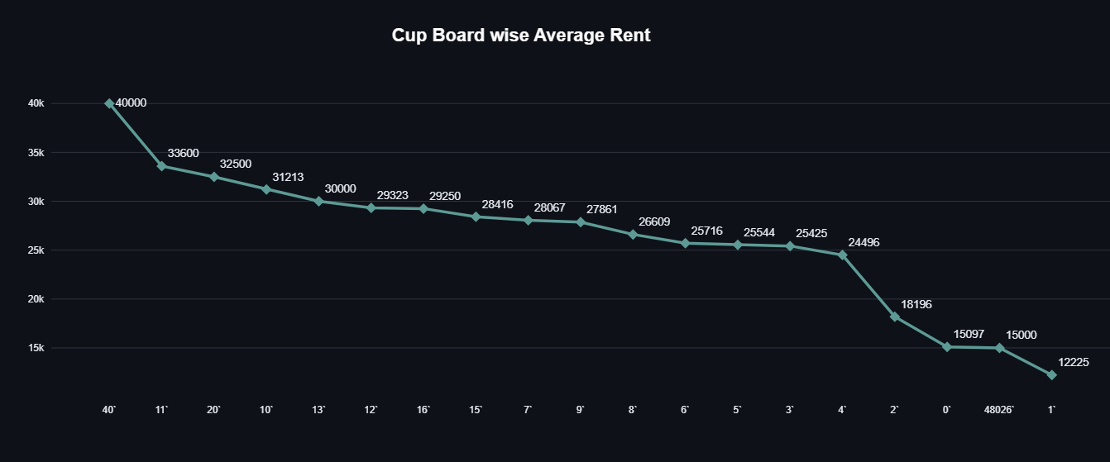

Slide 10
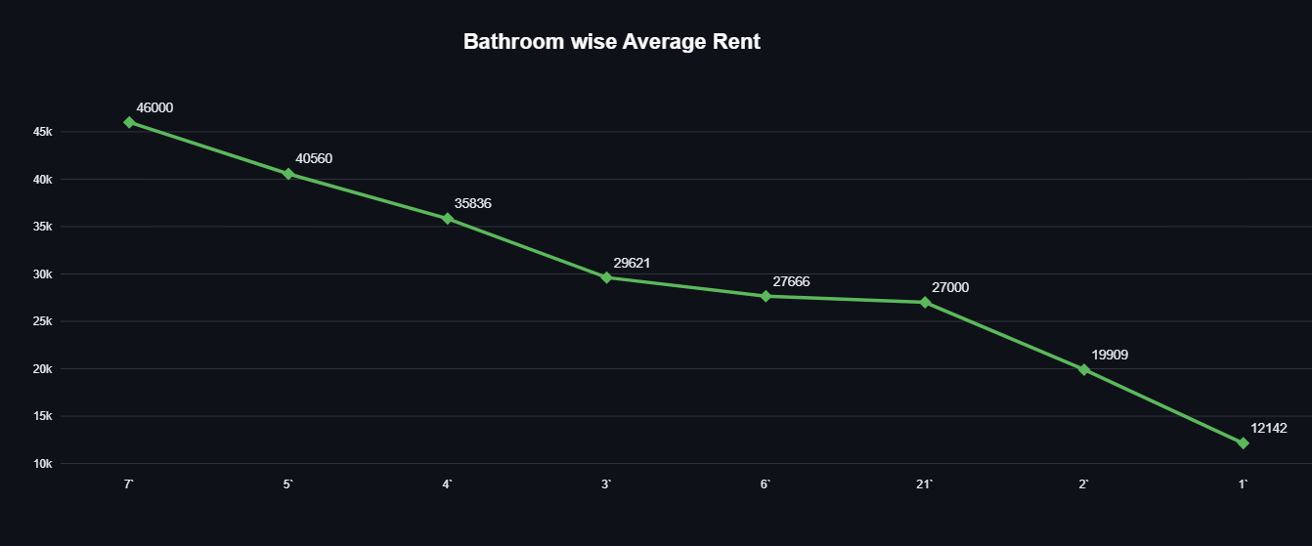

Slide 11
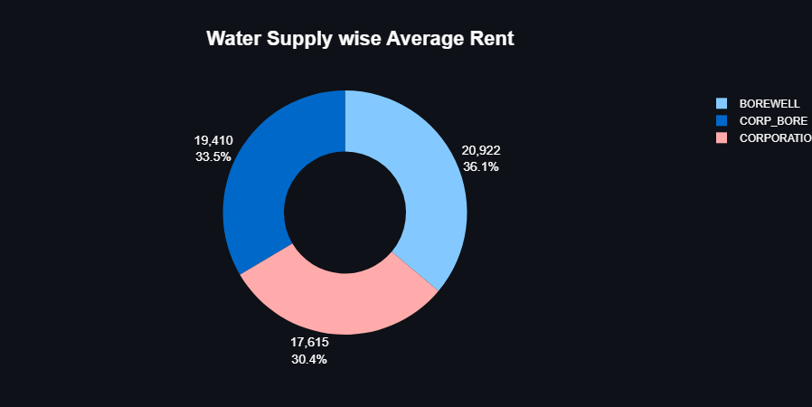

Slide 12
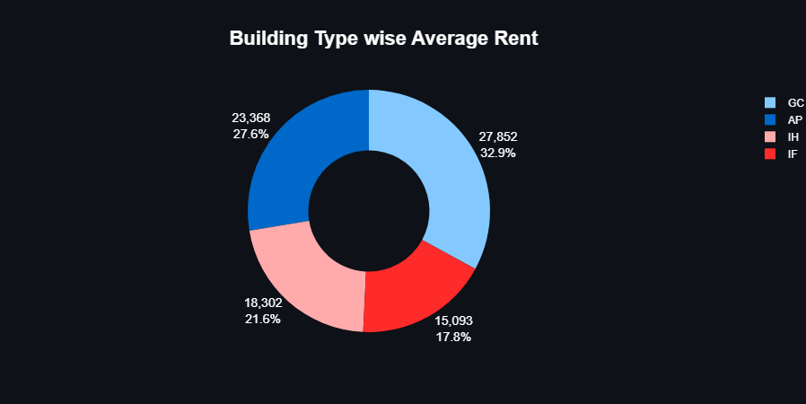

Slide 13
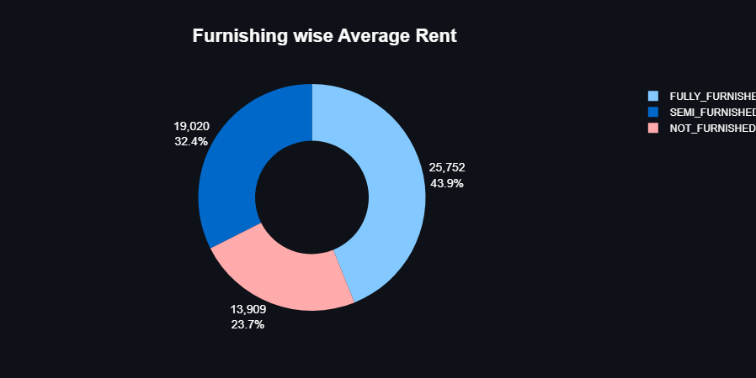

Slide 14
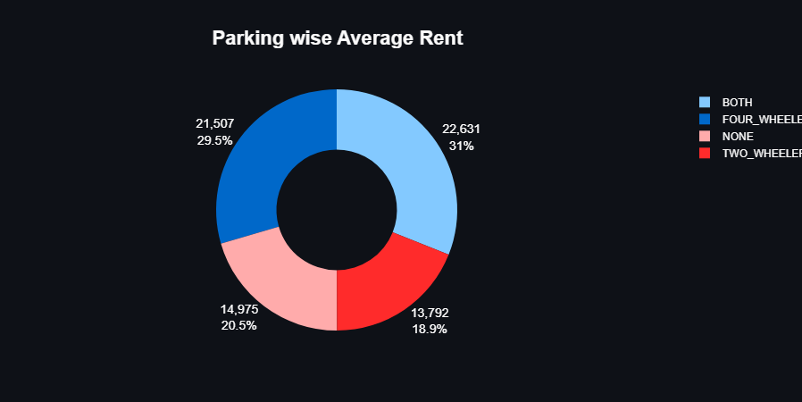

Slide 15
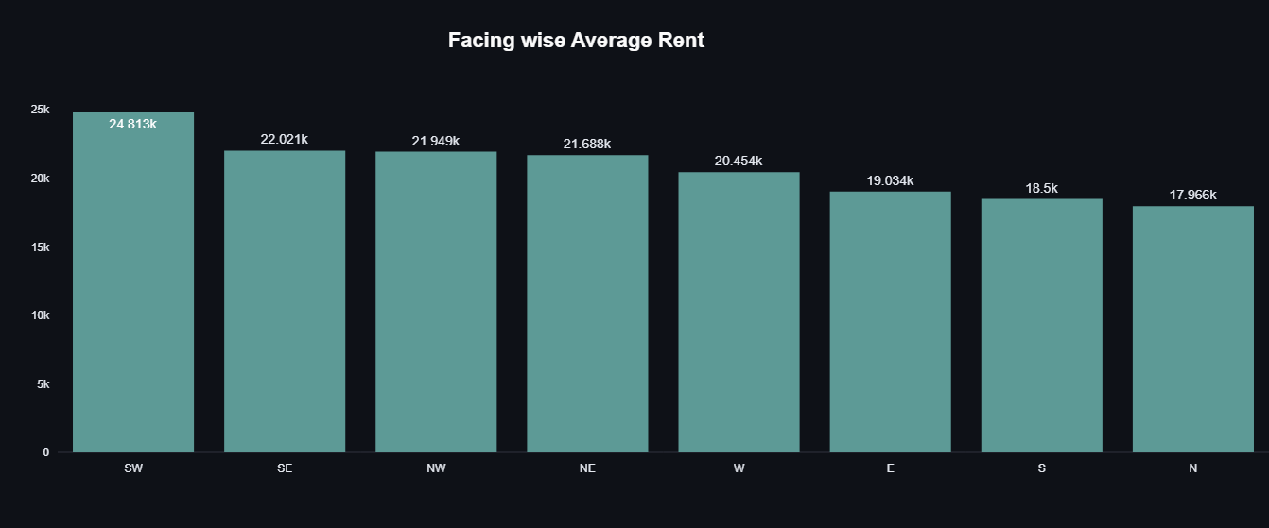

Slide 16
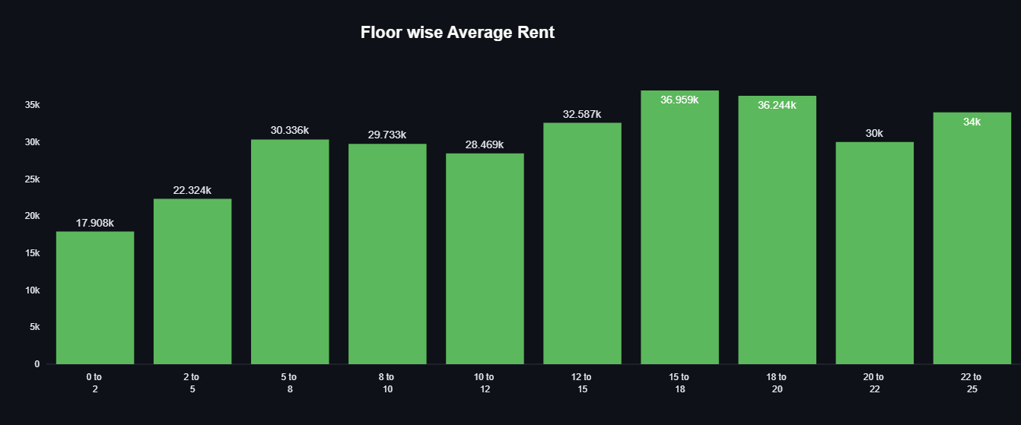

Slide 17
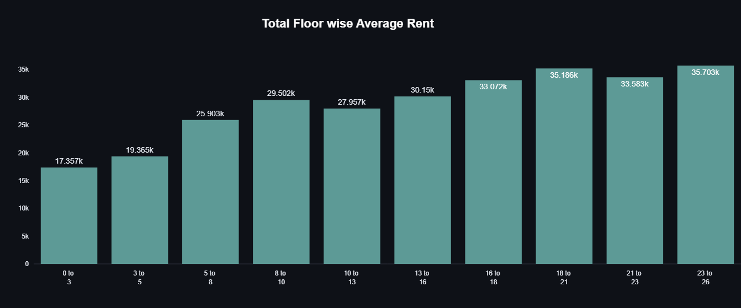

Slide 18
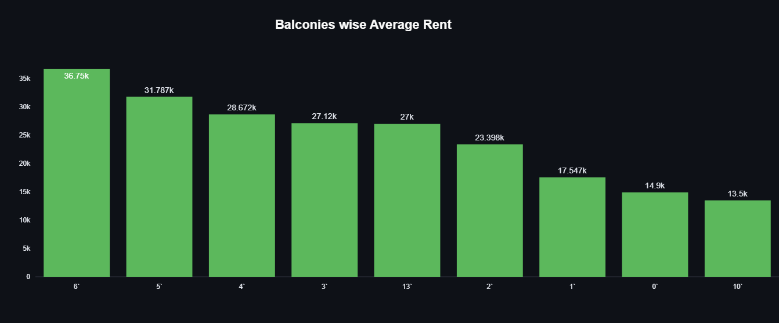

Slide 19
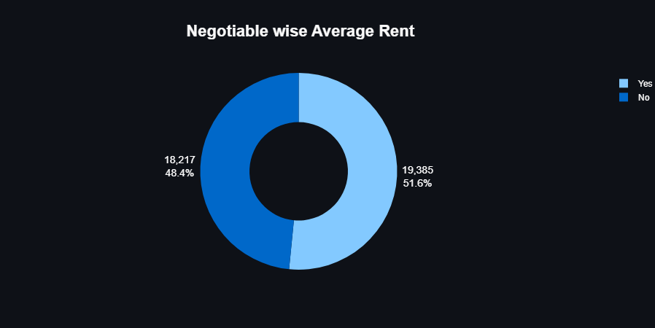

Slide 20
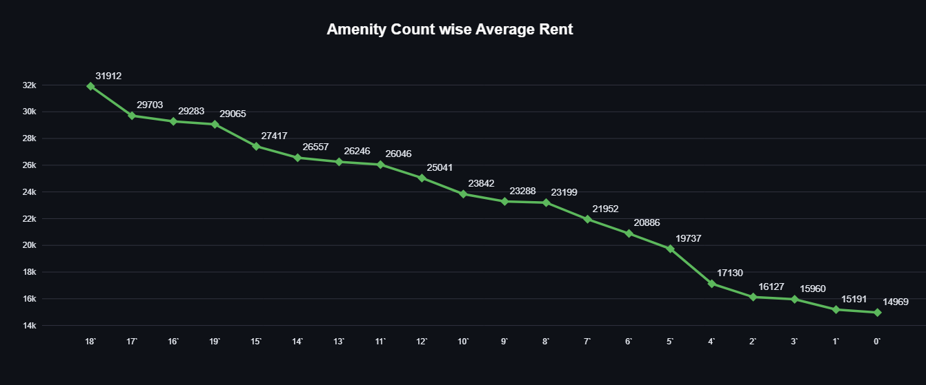

Slide 21
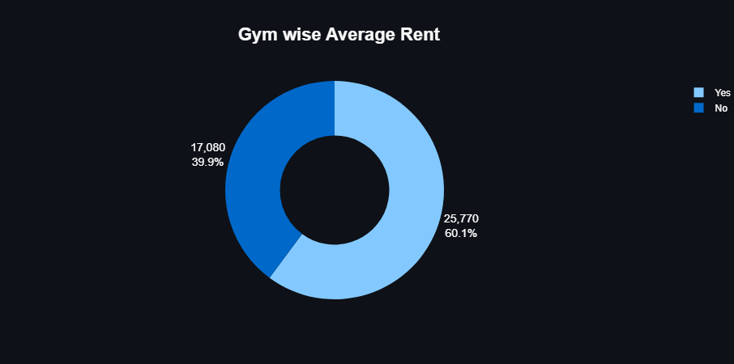

Slide 22


Slide 23
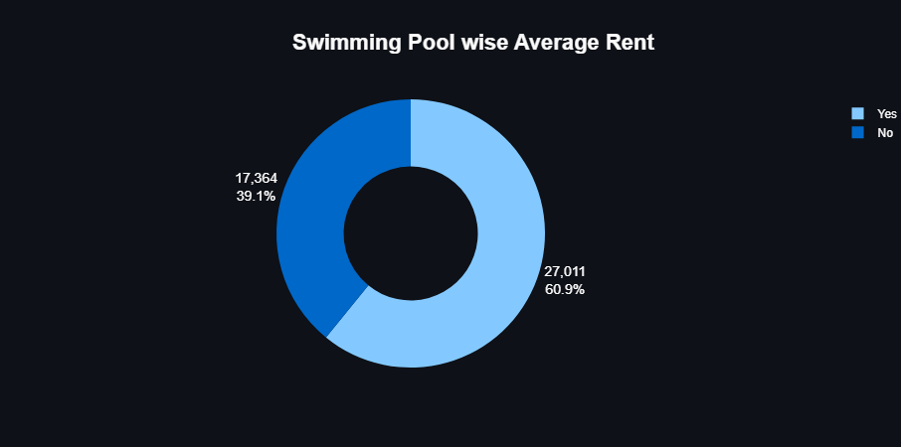

Slide 24
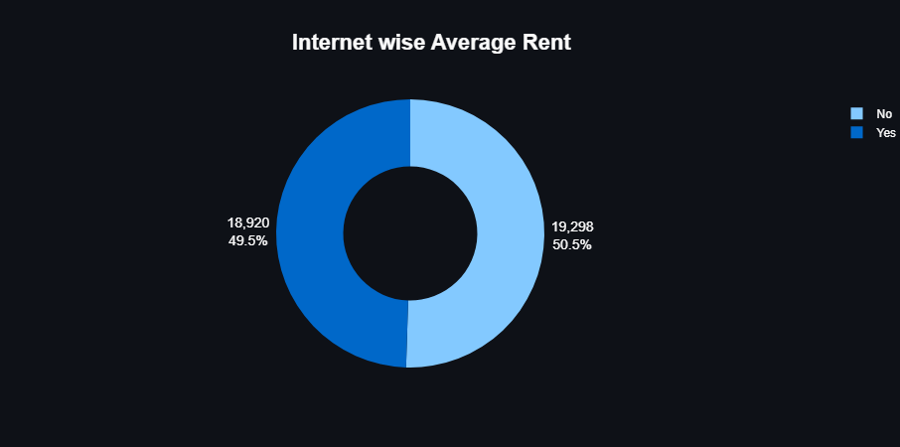

Slide 25


Slide 26


Slide 27
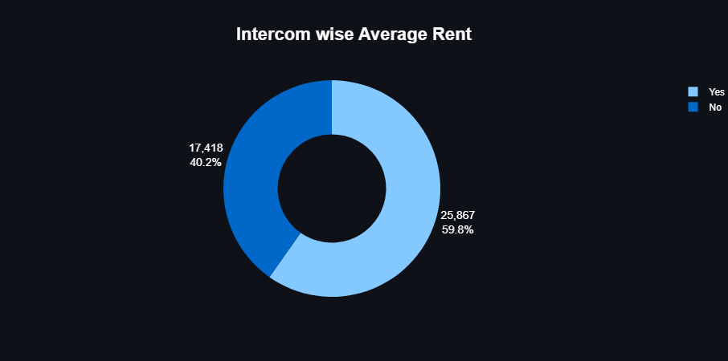

Slide 28
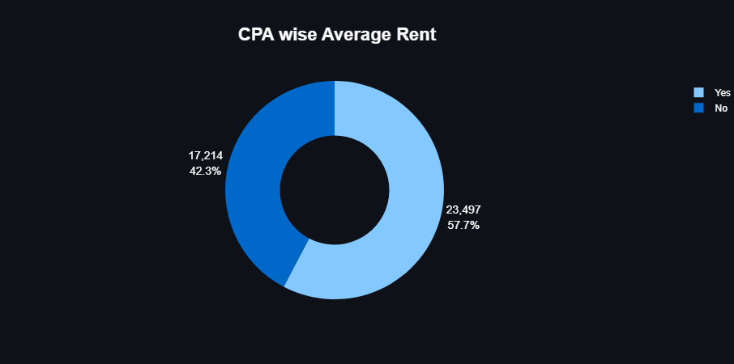

Slide 29
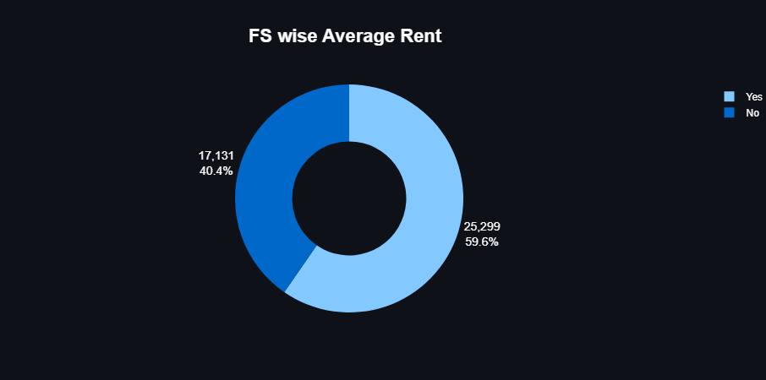

Slide 30


Slide 31


Slide 32


Slide 33
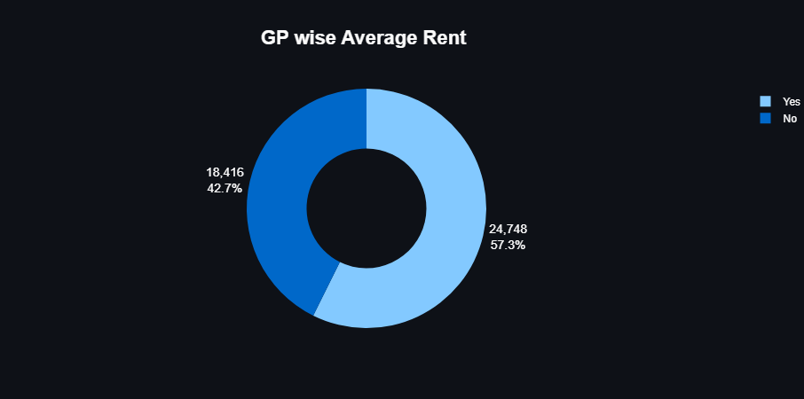

Slide 34
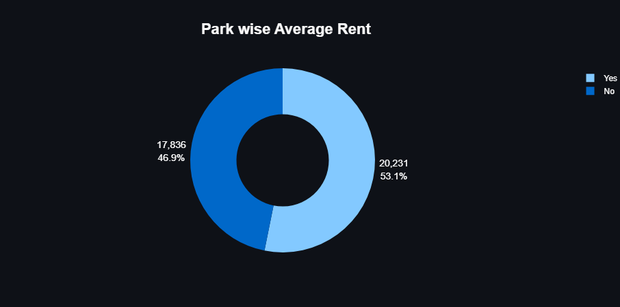

Slide 35
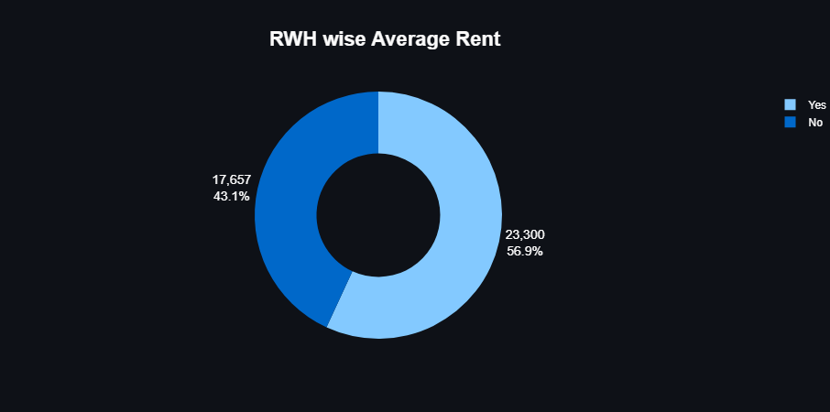

Slide 36
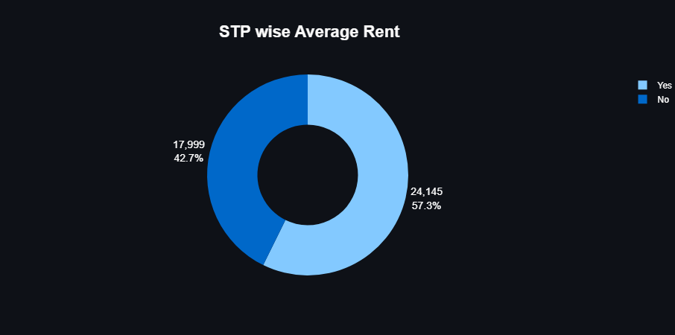

Slide 37


Slide 38


Slide 39


Slide 40


